Slide 1
What makes an appropriate source
Discuss reference sources
Narrowing your topic
Identify search terms to find journal articles
Finding Newspapers
Finding books
Creating MLA citations

Slide 6
Education

Slide 7
Despite a four-year degree boosting lifetime earnings over those of high school graduates, this does not apply to all graduates, meaning that a four year degree is not always a sound investment.

Slide 9
If you need an idea look at CQ Researcher and/or Opposing Viewpoints databases.

Slide 10
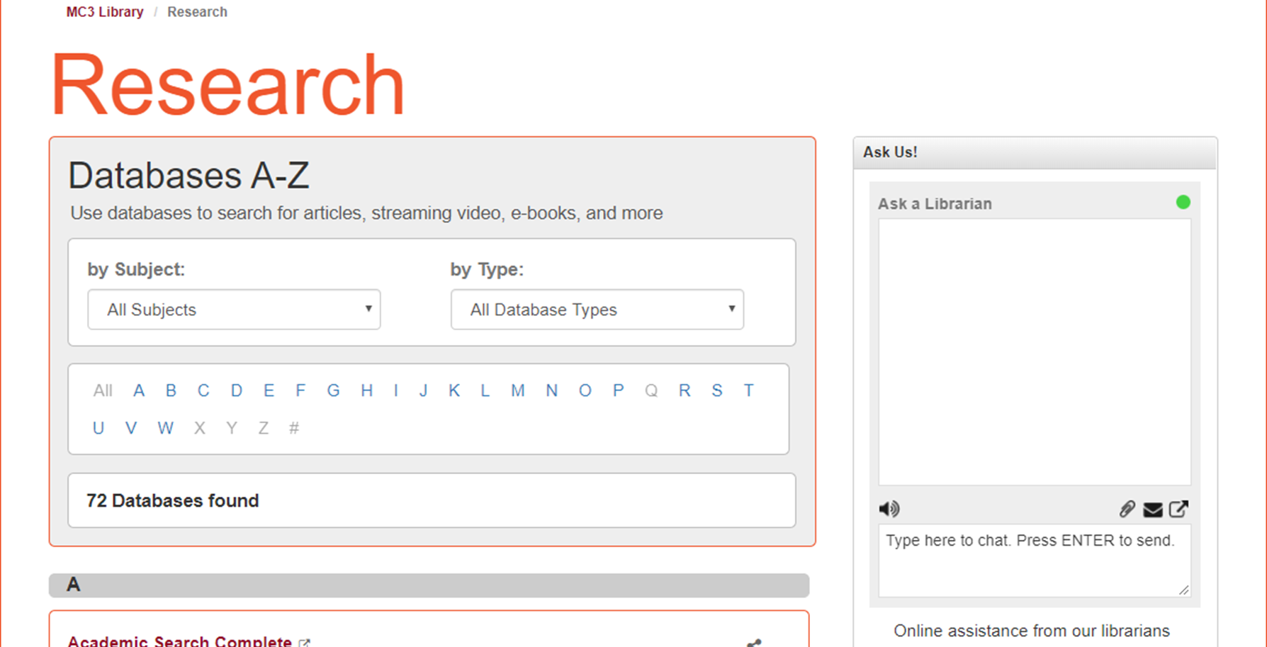

Slide 11
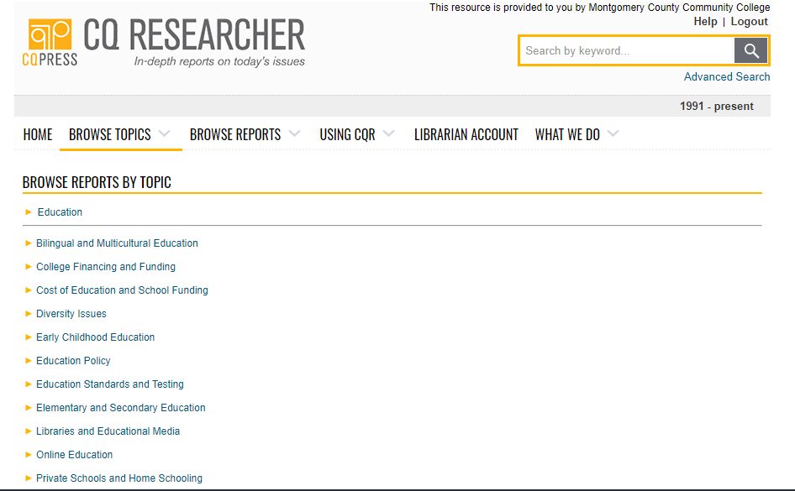

Slide 12
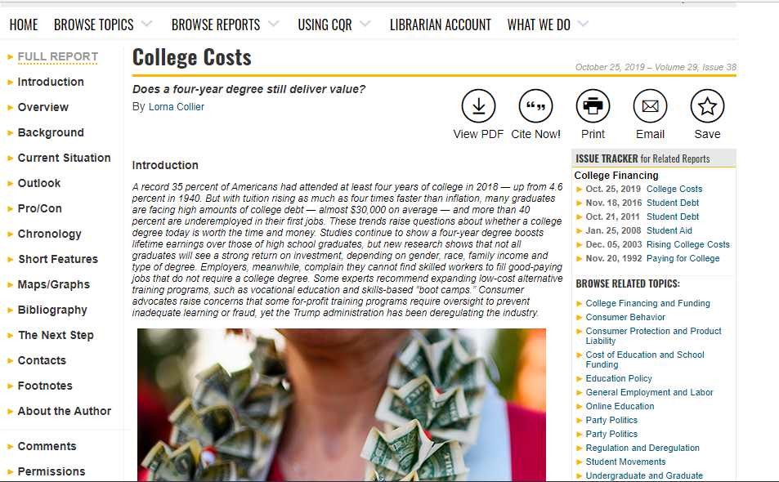

Slide 13
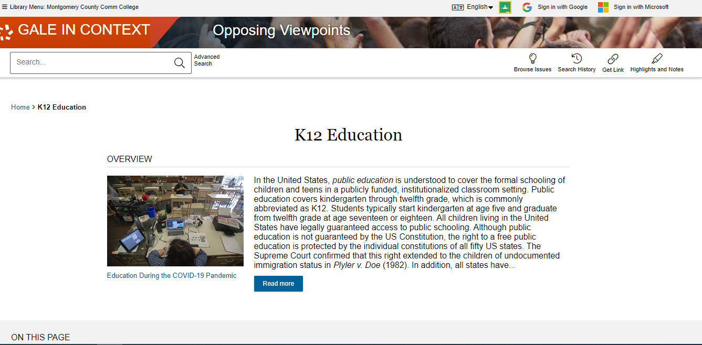

Slide 14
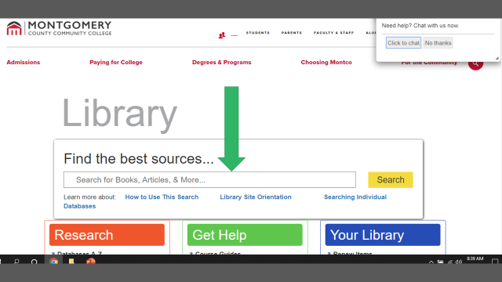

Slide 16
What is a scholarly article?
You need at least one of them.

Slide 17
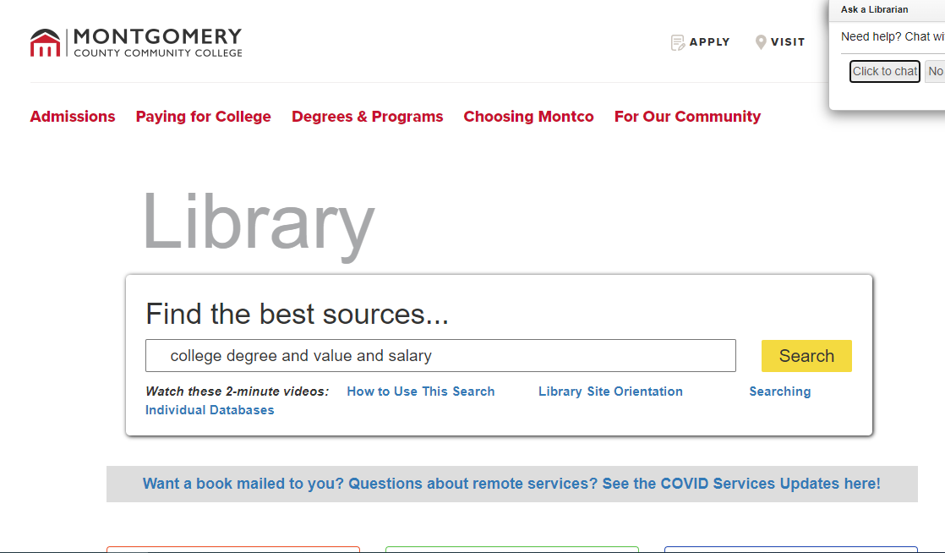

Slide 18
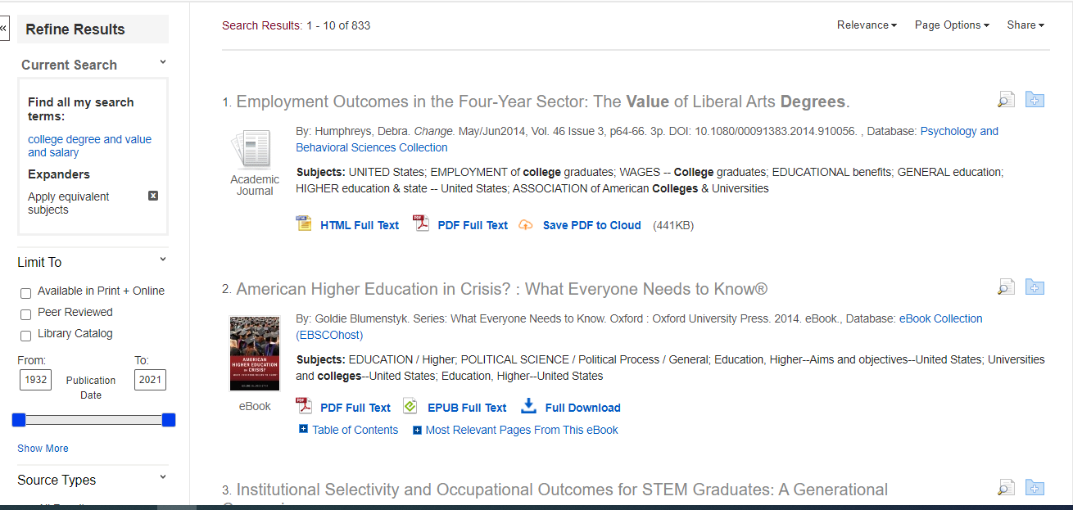

Slide 19
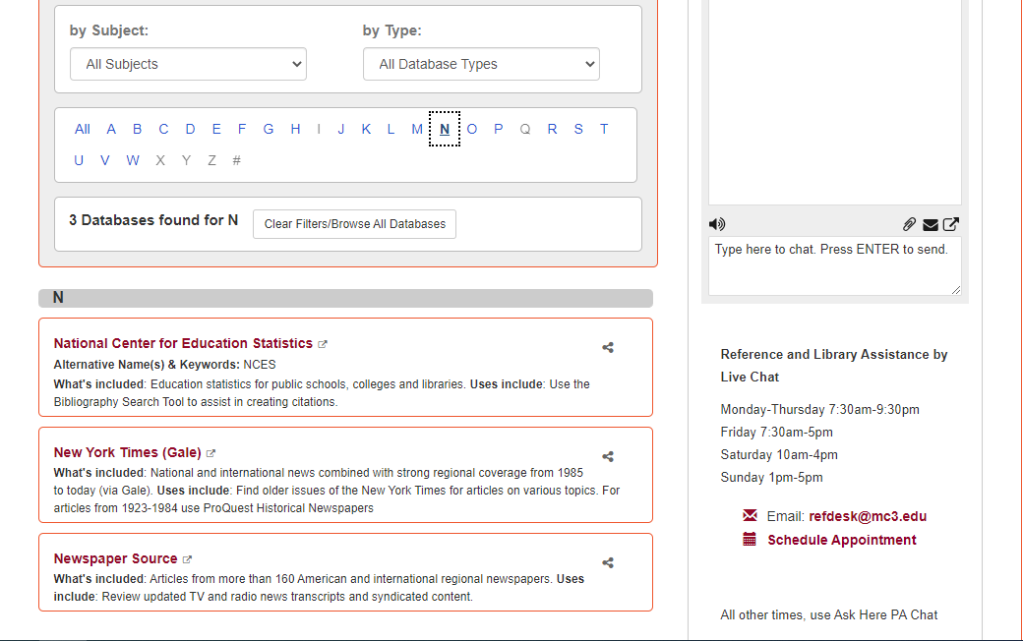

Slide 20
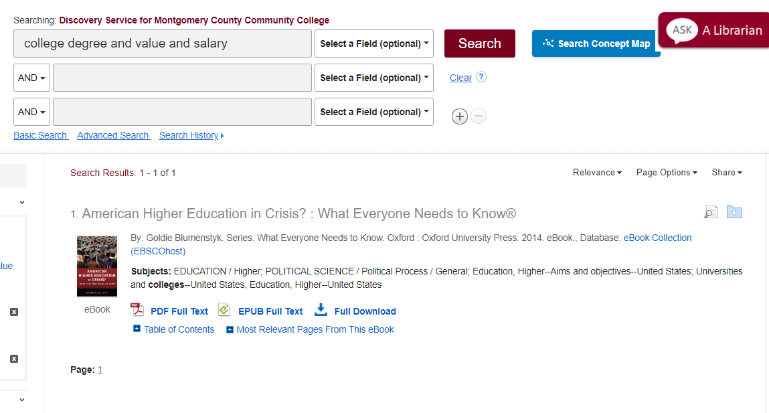
There are e books available for this assignment

Slide 21
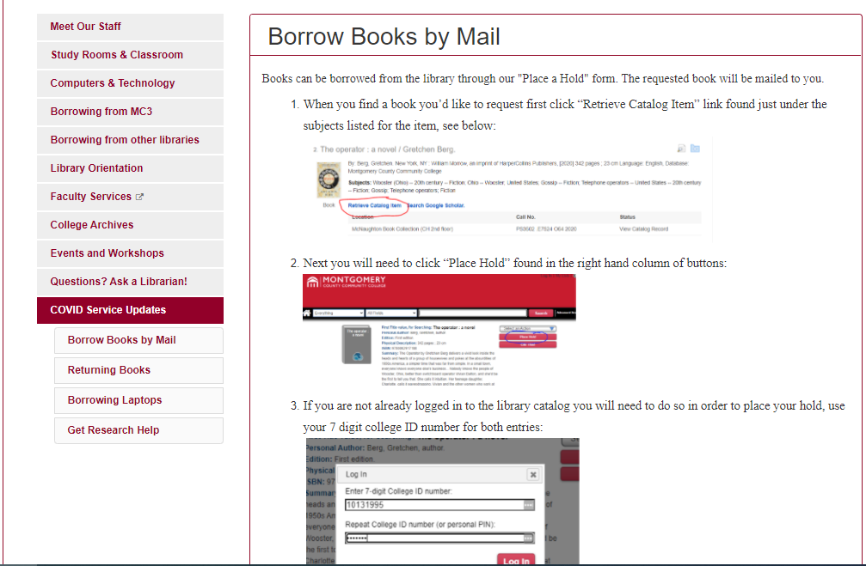
You can get a library book mailed to you.

Slide 23
You can fine tune your internet search results to education or non-profit/organization sites by searching student debt ;.edu or ;.org

Slide 24
Evaluating websites

Slide 25
MLA Help
MLA Sample Paper

